Slide 1
Classification of Life

Slide 2
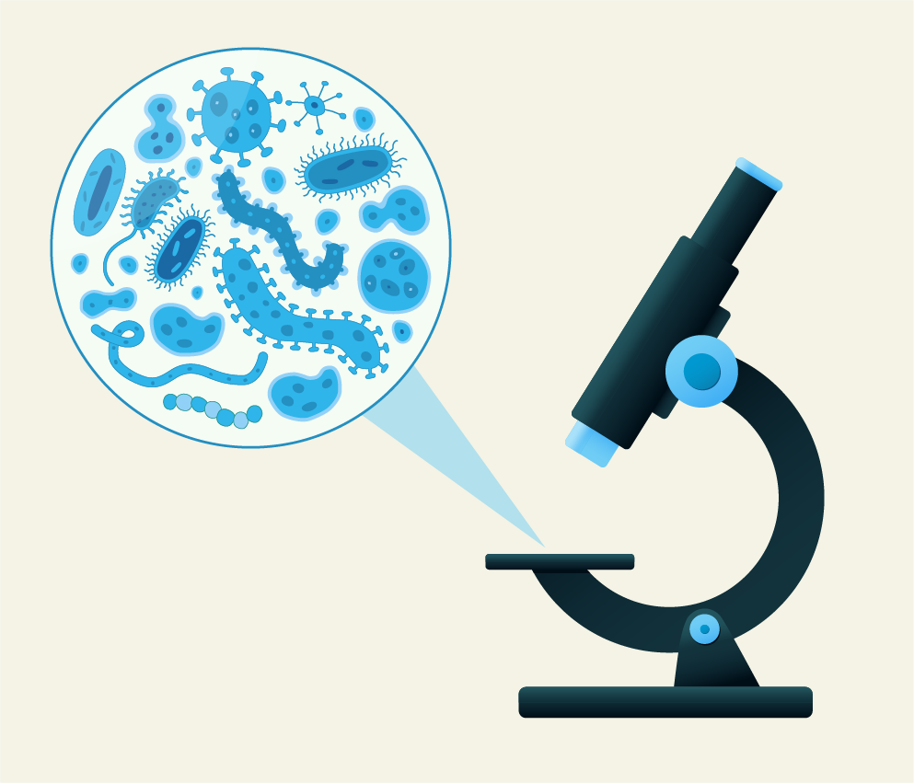
By the end of this lesson, you should be able to:
Describe the three main domains of life.
Describe the four eukarya kingdoms.

Slide 3
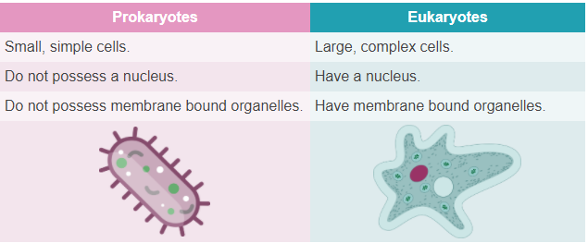
All living organisms can be classified as either prokaryotes or eukaryotes.
Prokaryotes are small, simple cells which lack a nucleus or membrane-bound organelles.
Eukaryotes are large, complex cells with a nucleus and membrane bound organelles.
Here’s a handy trick for you to remember the difference between prokaryotes and eukaryotes. “Pro” rhymes with “no”. Prokaryotes have no nucleus or membrane bound organelles. “Eu” rhymes with “do”. Eukaryotes do have a nucleus and membrane bound organelles.

Slide 4
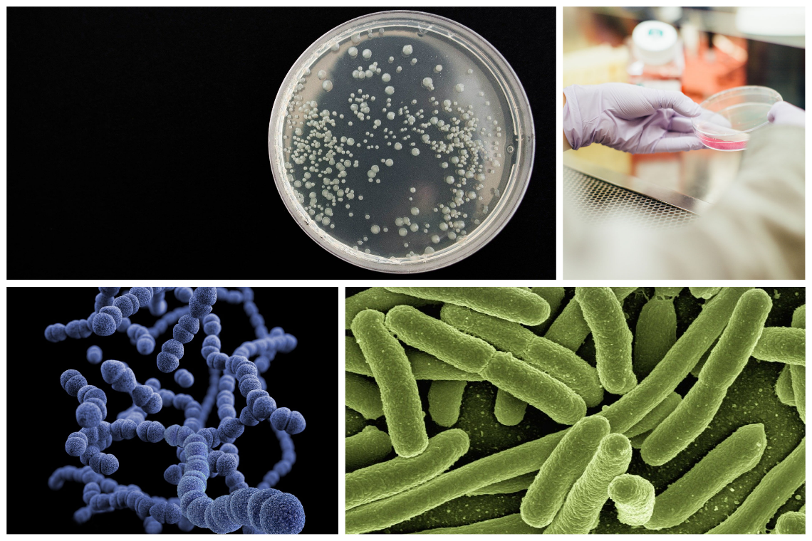
From this initial classification of prokaryotes and eukaryotes, organisms can be further categorised into specific domains.
In prokaryotes, organisms can be categorised into the domains of bacteria or archaea. In eukaryotes, organisms are classified as belonging to the eukarya domain.
Bacteria are all around you. They are on your skin, in your gut, on your desk, in your water bottle—sorry if that grosses you out! They are prokaryotes and are strictly unicellular. The domain of bacteria is familiar to most people when associated with human diseases (i.e. cholera). However, it is estimated that less than 1% of the currently known bacteria species are able to cause disease.

Slide 5
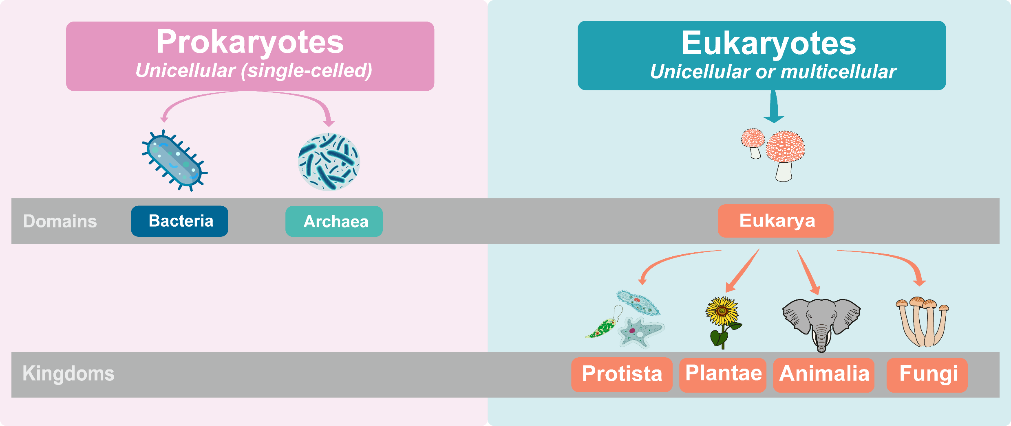
The next domains of life are archaea and eukarya.
Archaea can be thought of as life’s extremists! These prokaryotic cells are found typically in extreme environments (i.e. in temperatures above 60ºC or even temperatures below freezing). Their unique structure of archaea means they are better able to withstand higher temperatures and stronger acid concentrations.
Eukarya are composed of eukaryotic cells. They can be further divided into the kingdoms of protista, fungi, plantae and Animalia kingdoms. Let's take a closer look at each of these four kingdoms.

Slide 6
After domains and kingdoms, living organisms can be further classified into specific categories.
The classification of living things includes eight levels: domain, kingdom, phylum, classes, order, families, genus and species.
The science of naming, defining and classifying groups of living organisms is called taxonomy.
Domain: Bacteria, archaea and eukarya.
Kingdom: In eukarya there are four kingdoms: Animalia, Plantae, Protista and Fungi.
Phylum: Kingdoms are then divided into smaller groups based on similar physical characteristics.
Classes: Phylum are then further divided into classes (i.e.humans belong to the mammalia class).
Order: There are 19-26 orders of mammalia.
Families: More specific than order.
Genus: This is the first part of an organism’s scientific name. An organism’s scientific name is always italicised, with the genus name capitilised.
Species: The most specific taxonomic rank. This is the second part of an organism’s scientific name & is not capitalised. There are an estimated 8.7 million different species on Earth.

Slide 7
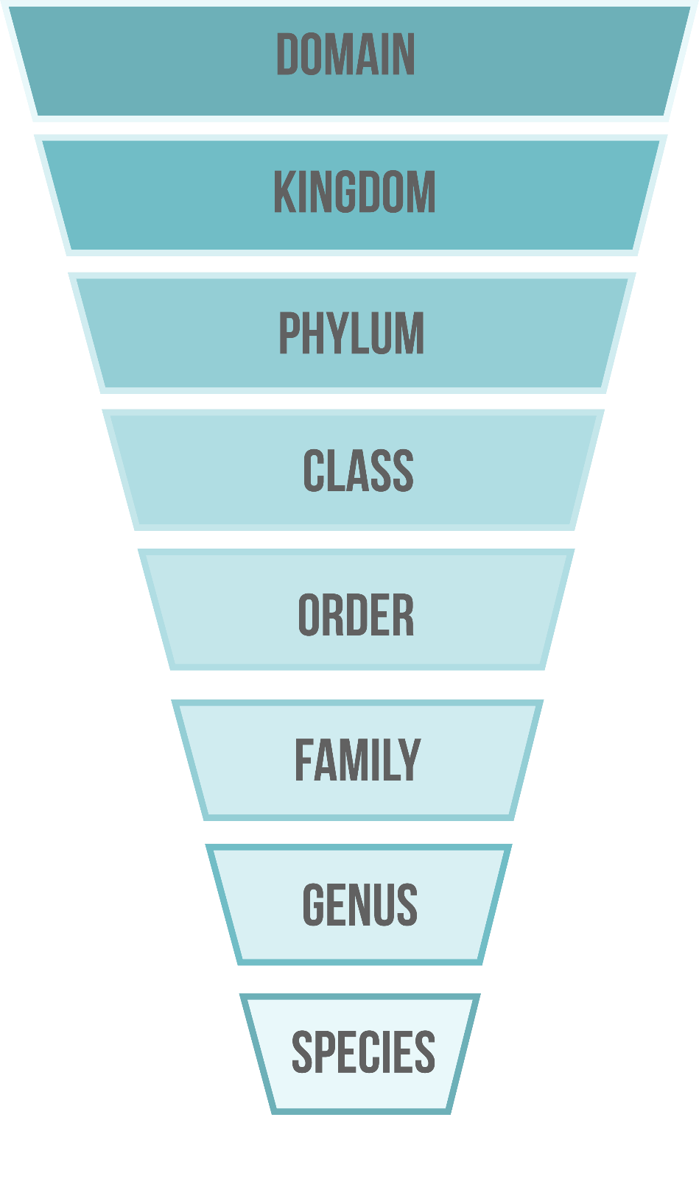

Slide 8

Now you know the eight taxonomic levels used in the classification of life. Let’s apply it to a specific living creature—the red fox or Vulpes vulpes!
Domain: The red fox belongs to the domain eukarya.
Kingdom: The red fox belongs to the kingdom Animalia.
Phylum: The red fox belongs to the chordata phylum.
Classes: The red fox belongs to the mammalia class.
Order: The red fox belongs to the class carnivora (large carnivores/omnivores).
Families: Red foxes belong to the canidae family (includes all dogs, wolves and foxes).
Genus: The red fox is part of the Vulpes genus.
Species: The red fox belongs to the vulpes species.

Slide 9

Now it's your time to classify organisms into their domains and kingdoms!
Take a look outside. How much life can you see out there?
Your mission, should you choose to accept it, is to explore the garden at home or the sports field at school.
Find and record 10 organisms—flowers, birds, bugs, worms, anything! You can draw pictures of them or ask your teacher what they are called.

Slide 10

To conduct your investigation, follow the steps below...
Go outside with a pen and paper.
Find 10 different organisms—trees, birds, bugs, whatever!
Draw each organism or write down its common name.
Come back inside and move on to the next task.

